Slide 1
Medical World

Slide 2
Our idea about medical products, first you should have an account to enter our website, then you will see our welcome and main page if you press on any product you will see all information about it.

Slide 3
1.Our site is easy to use and doesnot have hard constrains.
2.Easy to find information that facilitates the processes of buying and selling.
3.Easy to learn and has a large memory that can save information.
Project features:

Slide 4
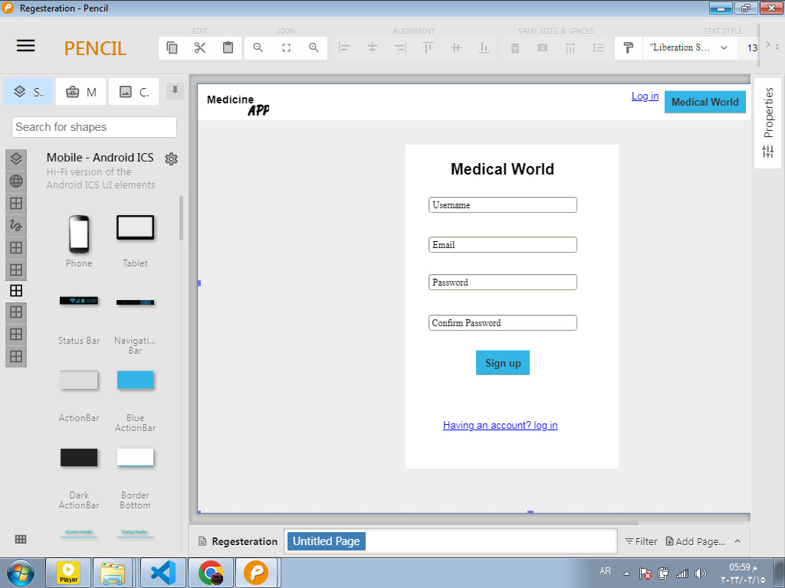
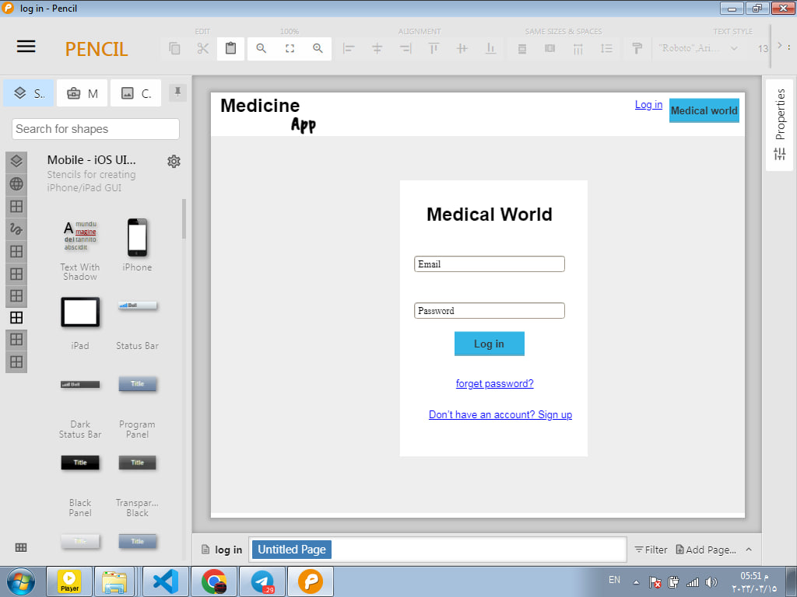
Login and Registeration Page by pencil
You should have an account if you have account sign up to go to next page.

Slide 5
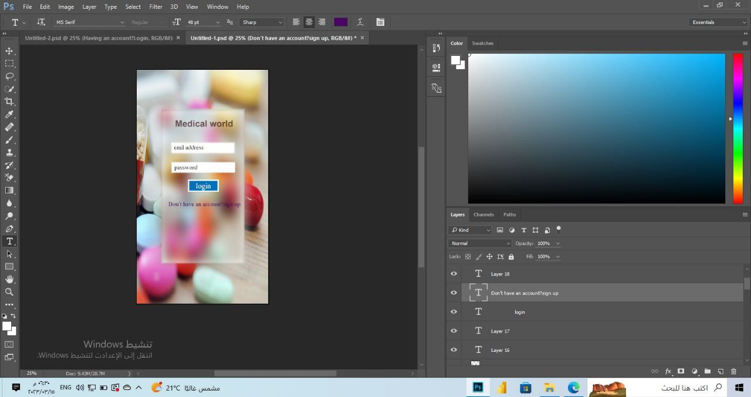
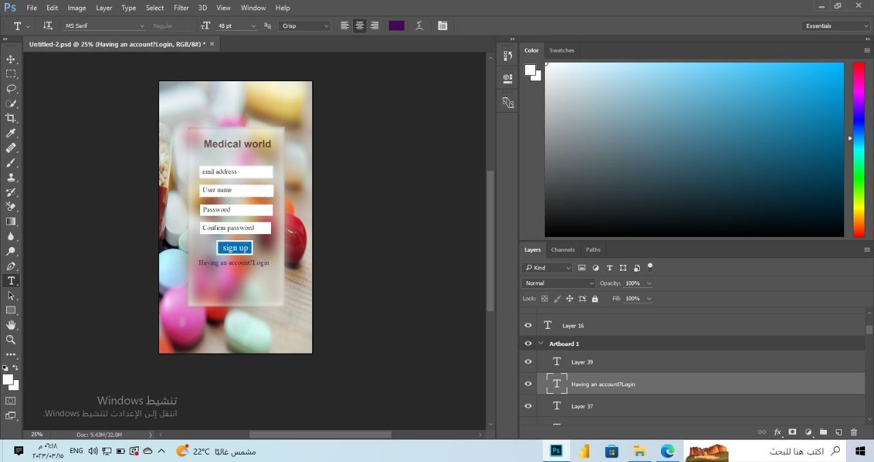
Login and Registeration Page by adobe
You should have an account if you have account sign up to go to next page.

Slide 6
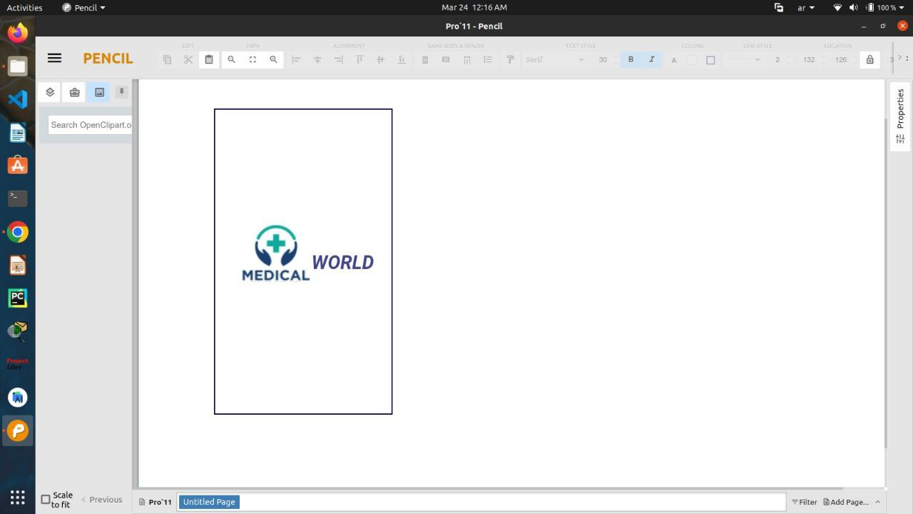
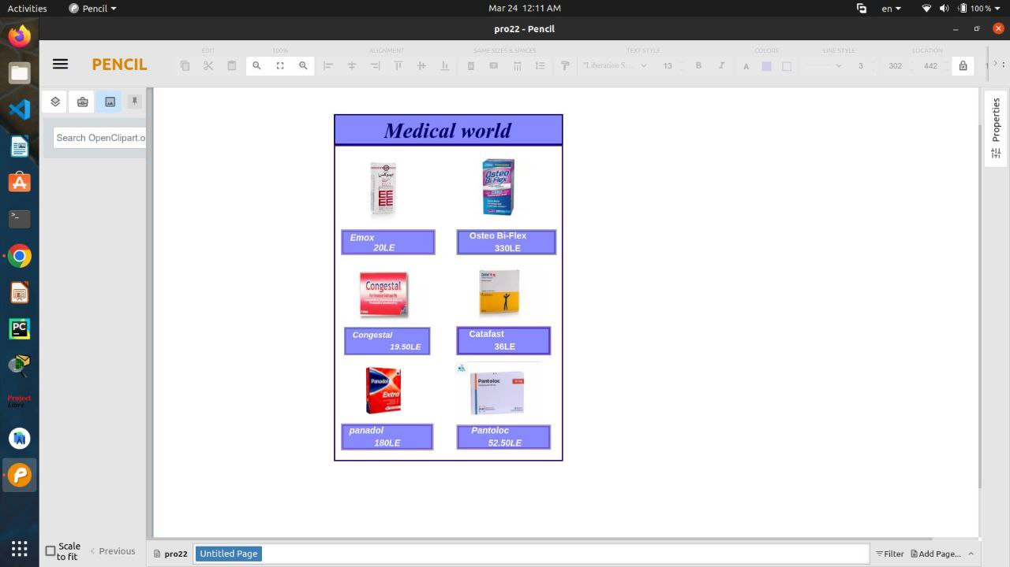
Main and Welcome Page by pencil
You will see the product we have.

Slide 7
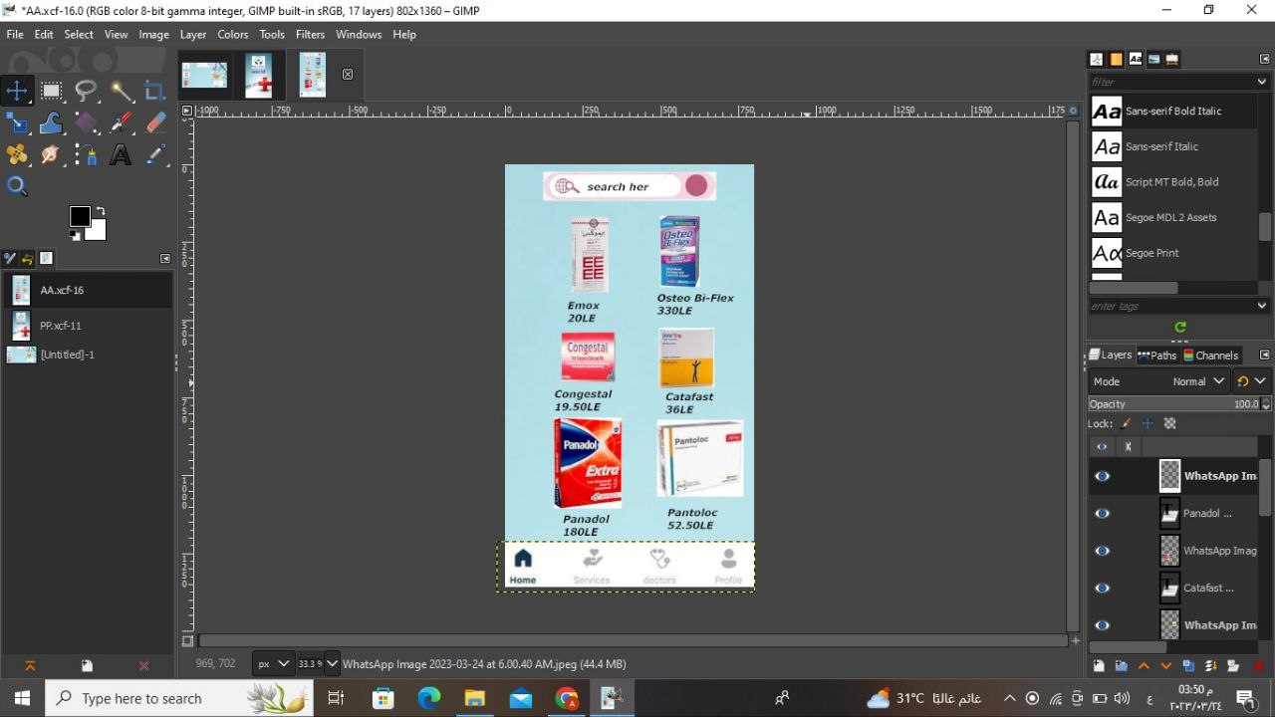
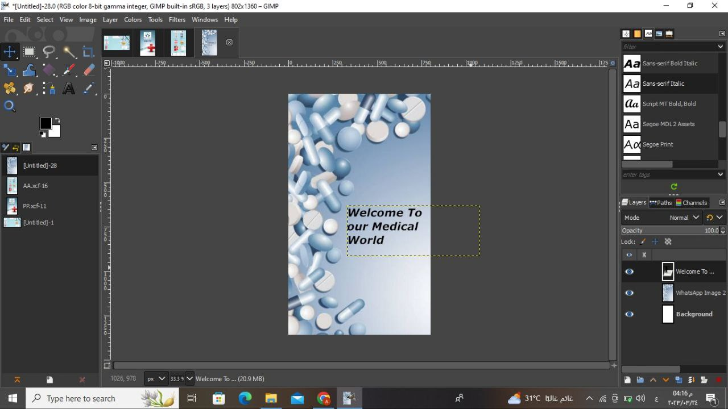
Main and Welcome Page by adobe
You will see the product we have.

Slide 8
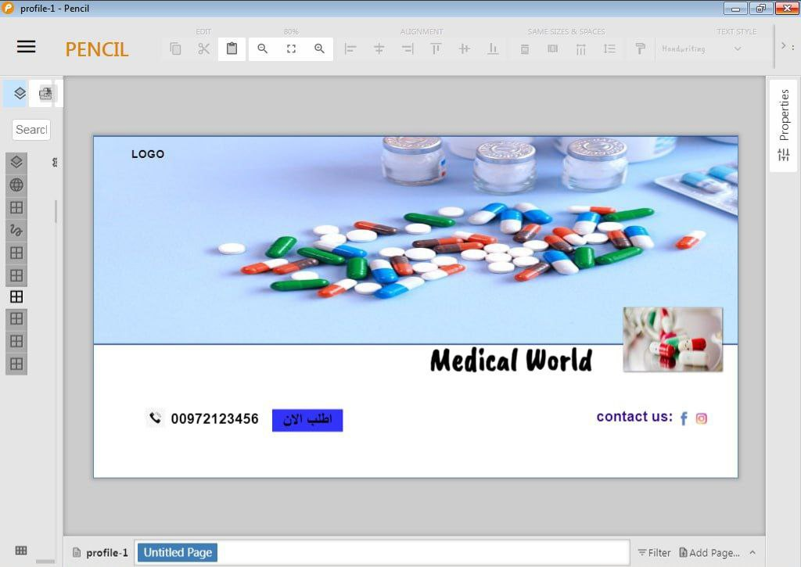
Project profile

Slide 9
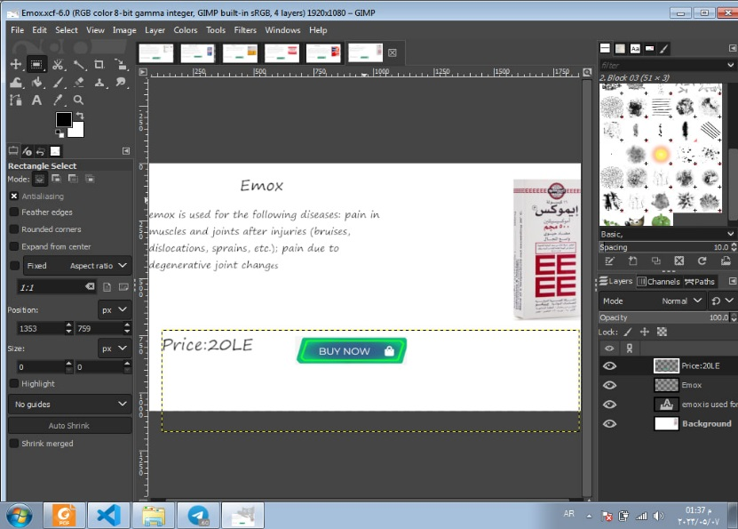
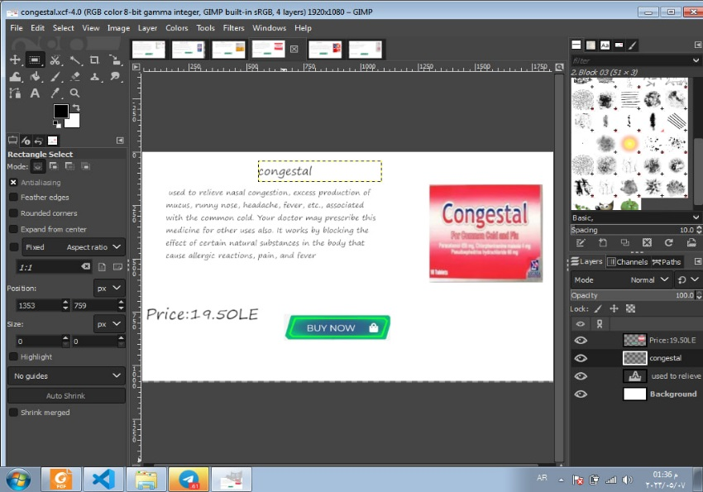
Details Page by adobe
You will see all information and details about product.

Slide 10
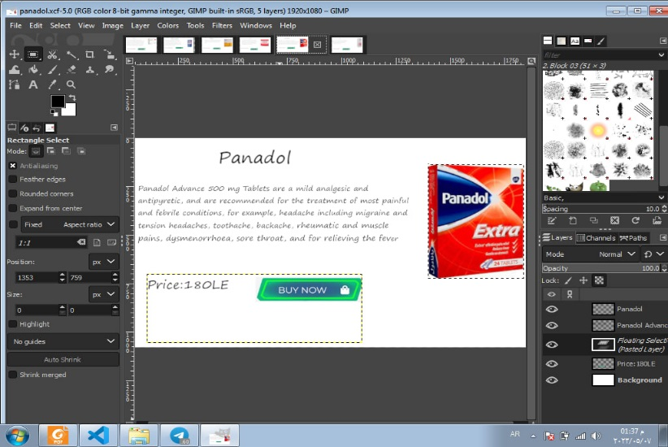
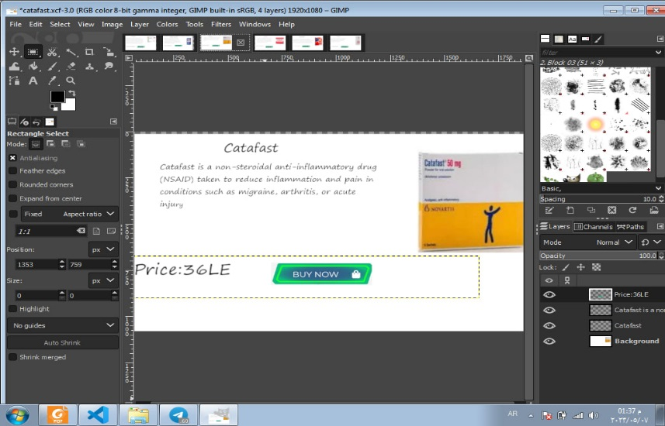
Details Page by adobe
You will see all information and details about product.

Slide 11
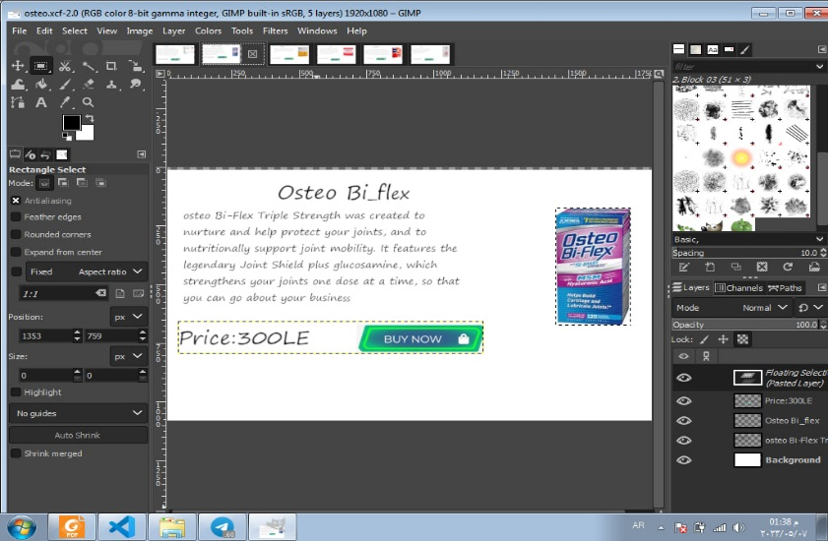
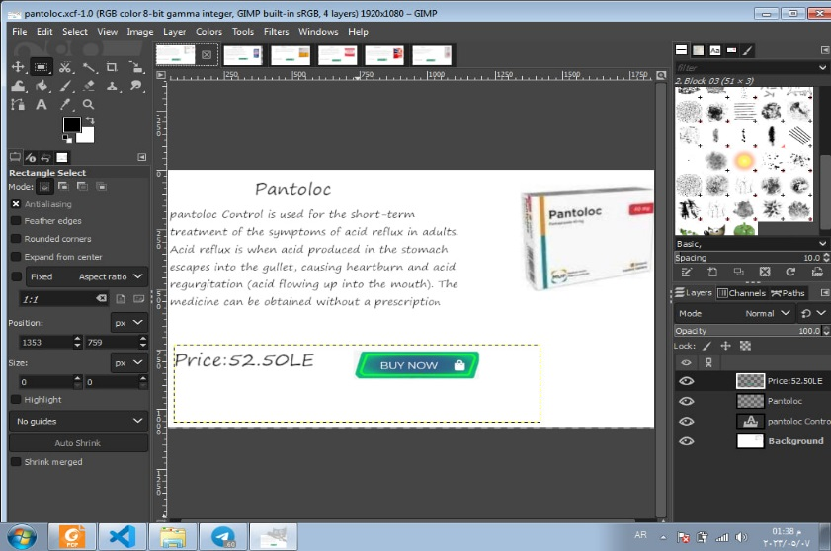
Details Page by adobe
You will see all information and details about product.

Slide 12
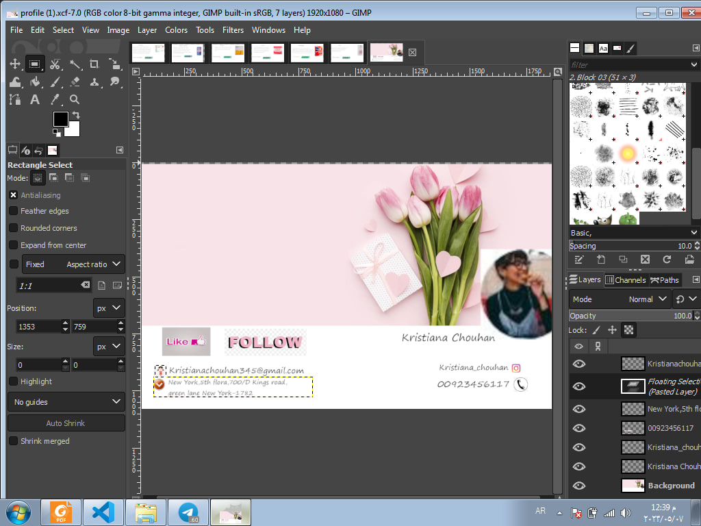
User profile by adobe
Information about user.

Slide 13
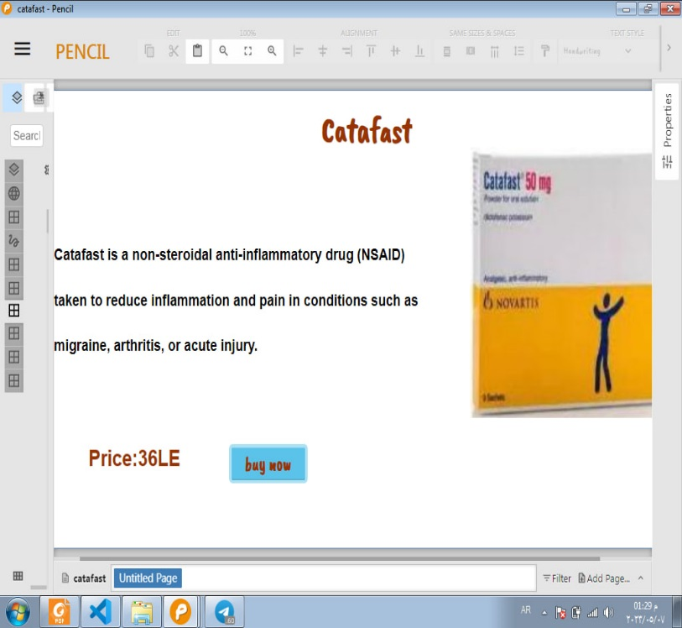
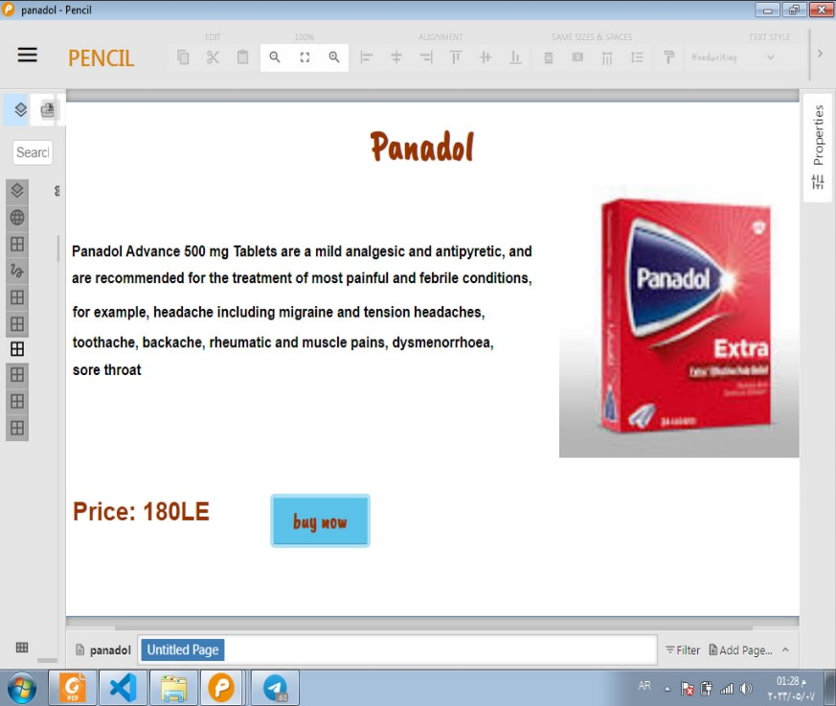
Details Page by pencil
You will see all information and details about product.

Slide 14
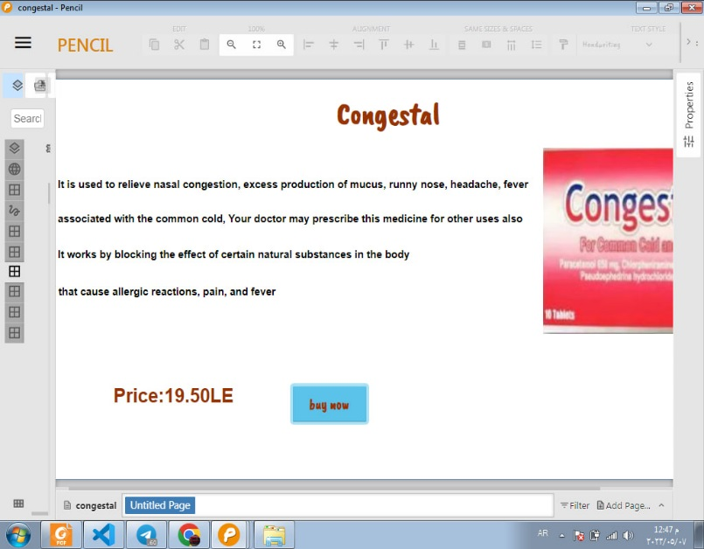
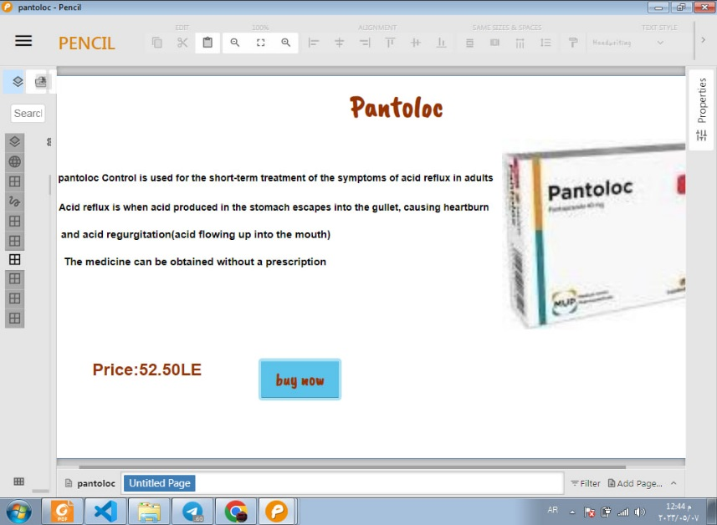
Details Page by pencil
You will see all information and details about product.

Slide 15
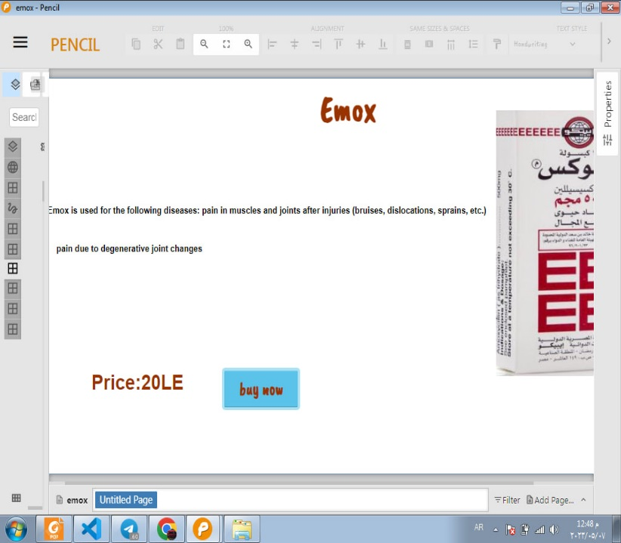
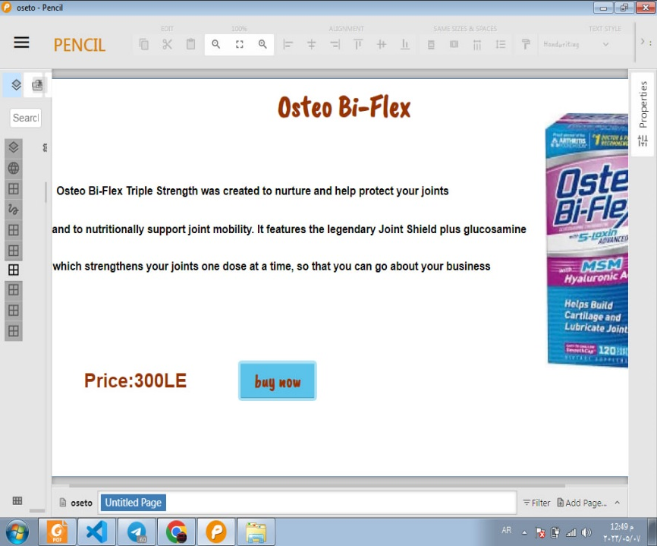
Details Page by pencil
You will see all information and details about product.

Slide 16
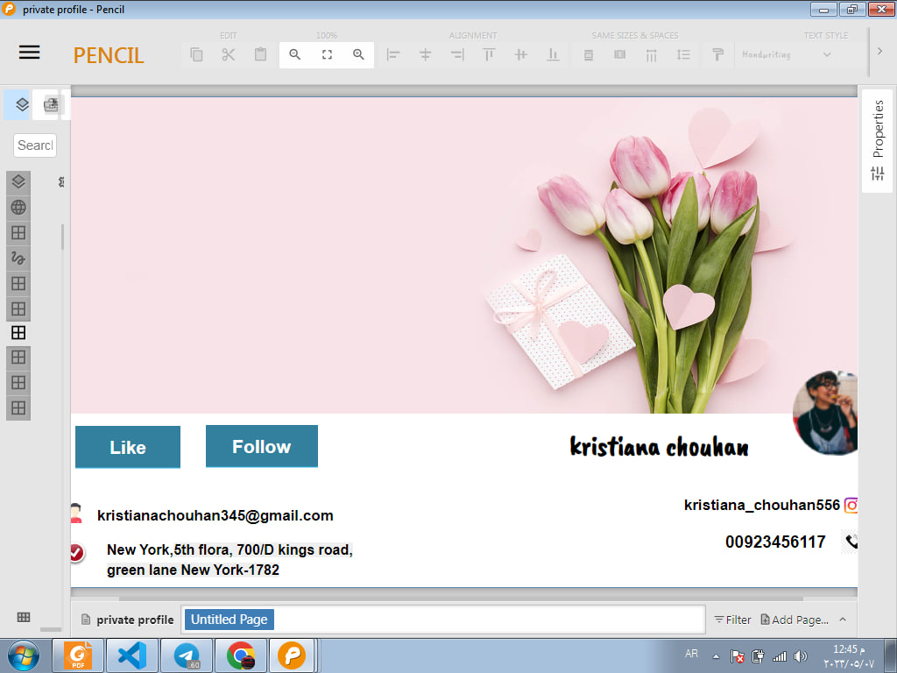
User profile by pencil
Information about user.

Slide 17
SuperVised By :
Dr . Fawzya Ramdan
Eng . Asmaa Soudy
Shahd Ahmed Hussien
Reem AbdElhamid Mohamed
Dana Abdallah Mahmoud
Wessam Ayman Tawfik
Alaa Mamdouh Ahmed
Shereen Mohamed Sofyan

